Slide 1
Item/doc 8.5/(1) – AG-Ocean Engagement Plan
Third Session of the Infrastructure Commission
(INFCOM-3, 15-19 April 2024)
Dr Boris Kelly-Gerreyn/Chair, AG-Ocean
18 April 2024

Slide 2
AG-OCEAN
INFCOM-2 session approved the recommendations of the former Study Group on Ocean Observations and Infrastructure Systems (SG-OOIS) to establish AG-Ocean to:
Build connections between WMO and ocean infrastructure across observations, data and prediction systems
Enable WMO to draw on and contribute to ocean capability in advancing Earth System Approaches to meet its strategic objectives
Identify Gaps and develop Strategies to address them.
1
2
3
4
5
6

Slide 3
AG-OCEAN clarity on mission
Our role is advisory
We advocate, advise and champion and we do NOT implement
We can't address everything stakeholders want us to do
1
2
3
4
5
6

Slide 4
AG-OCEAN clarity on mission
Our role is advisory
We advocate, advise and champion and we do NOT implement
We can't address everything stakeholders want us to do
We focus on key priority areas where we can make a difference
Where connections are strong, we acknowledge
Where connections are weak or missing, we pay attention
1
2
3
4
5
6

Slide 5
AG-OCEAN clarity on mission
Our role is advisory
We advocate, advise and champion and we do NOT implement
We can't address everything stakeholders want us to do
We focus on key priority areas where we can make a difference
Where connections are strong, we acknowledge
Where connections are weak or missing, we pay attention
We will work closely with our stakeholders to
ensure our advice is based on the high(est) priorities
keep them informed, engaged and supportive
1
2
3
4
5
6

Slide 6
Engagement Plan – the first one!
Purpose of Plan– mechanism to strengthen and improve working connections between meteorological and oceanographic infrastructure in the context of the Earth System.
Articulates priority focus areas based on issue, gap and opportunity analysis drawing on key strategic documents, knowledge and expertise within AG-Ocean, and stakeholder input
Goal - to help establish long-term, operational working arrangements between the WMO and the ocean infrastructure community for the benefit of all nations.

Slide 7
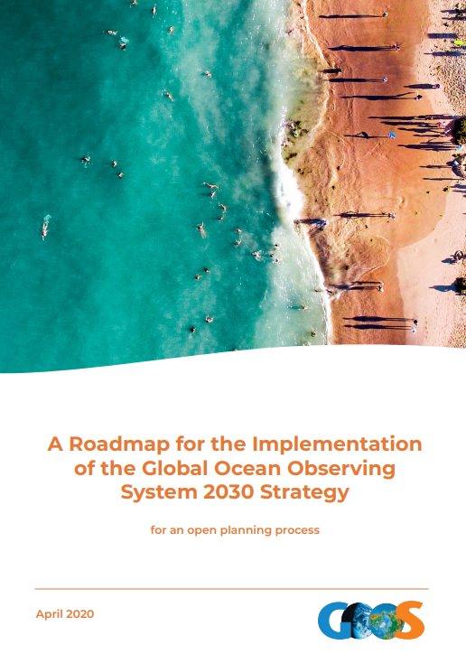
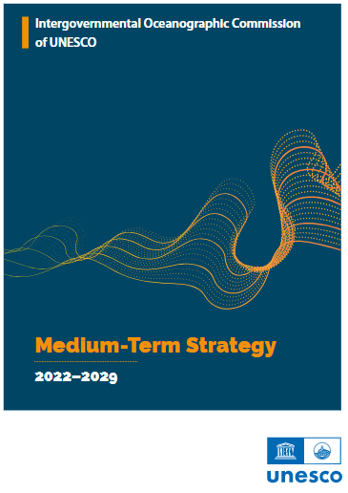
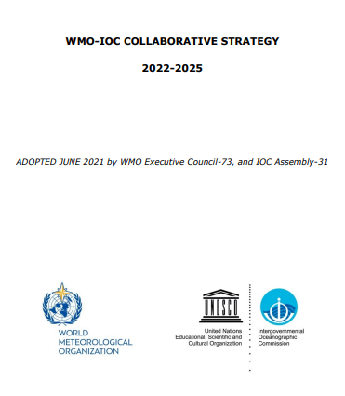
AG-Ocean context
Observations – sustained, integrated, responsive ocean observations
Data Sharing – FAIR, free and unrestricted
Prediction –Seamless ocean-atmosphere (Earth system) prediction

Slide 8
Consultation Journey
1
2
3
4
5
6

Slide 9
Engagement Plan Ouptuts
3 themes
12 focus areas
23 Recommended actions (others lead but AG-Ocean initiates and advocates)

Slide 10
Engagement Plan – Focus Areas
Observations (Lead: Ann-Christine Zinkann, US)
Assessment of GOOS and WMO connections
Synthesis of observing system requirements and evaluation activities
Ocean in GBON Implementation
Leverage regional structures to enhance regional implementation
Data (Lead: Axel Andersson, Germany)
Governance, coordination and support structures
Connect ocean and WMO metadata tools
Implementation of WIS 2.0 for ocean data
Integration of MCDS into WMO and IOC structures
Prediction (Lead: Elisabeth Remy, France)
Governance, coordination and support structures
Observing system evaluation and prediction requirements
Responding to authoritative guidance on requirements for ocean prediction products
Ocean analysis and forecasts evaluation

Slide 11
Thank you.
^{wmo.int}

Slide 12
Draft Decision 8.5(1)
Annex to draft Decision 8.5(1)/1 (INFCOM-3) (Edits)
Page 4: 1st paragraph
The complementary strategic initiatives of the World Meteorological Organization (WMO), the Intergovernmental Oceanographic Commission (IOC), the Global Ocean Observing System (GOOS)[1] and the UN Decade of Ocean Science for Sustainable Development 2021–2030 (UN Ocean Decade) highlight the interconnectedness of the Earth's systems. They all strive for a more [Spain] resilient Earth by 2030, sharing a focus on a globally integrated observation network, data exchange and predictions for weather, ocean, and climate.
Bulet # 3
Enabling Prediction and Informed Decisions: Coupling real-time data with powerful models to generate accurate forecasts for weather, ocean, and climate, empowering informed decisions (and services) for a more [Spain] resilient future.

Slide 13
Annex to draft Decision 8.5(1)/1 (INFCOM-3)
Page 6:
2. Identifying observing gaps for WMO Rolling Review of Requirements (RRR) [HK-China] Application Areas;
Page 7:
Ocean prediction products and guidance on the use of products use [HK-China] for early warning and maritime safety; and
Ocean analysis and forecasts [HK-China] evaluation.

Slide 14
Annex to draft Decision 8.5(1)/1 (INFCOM-3)
Page 8: 1st paragraph
Notable exceptions include the Ocean Observations Panel for Climate (OOPCs) climate requirements via the Global Climate Observing System (GCOS), projects such as the Tropical Pacific Observing System (TPOS), and Expert Team on Operational Ocean Forecasting Systems (ETOOFS) [HK-China] identification of observing requirements. Some UN Ocean Decade programs, such as the GOOS Observing System Co-Design Programme, are increasing the development of observing system requirements and targeted development activities. Observing requirements within the WMO application areas are defined and gaps in observing systems are [HK-China] highlighted. The ocean community lacks both clarity on the WMO RRR and design of the observing system and clear dialogue to fill identified gaps within all application areas. An example priority gap that cuts across a number of application areas includes observations from drifting buoys and ships and there are significant risks associated with the capabilities used to collect, process and disseminate these observations. One significant avenue to explore is greater engagement with the International Maritime Organization (IMO) and large shipping companies to help both maintain and grow (by filling identified gaps) such observations. [UK, USA, Australia]

Slide 15
Annex to draft Decision 8.5(1)/1 (INFCOM-3)
Page 8:
under Recommended Action:
(c) Engages IMO, GOOS, OCG, and large shipping companies to explore alternate approaches to sustaining and growing these observations in line with needs, including mandating ship (meteorological and oceanographic) observations and setting standards for the quality and frequency of these observations and associated metadata [UK, USA, Australia]
A brief report will outline the gaps (identified by application areas) and provide recommendations for prioritization for consideration to JET-EOSDE (Joint Expert Team on Earth Observing System Design and Evolution) activities and actions, in consultation with other key stakeholders such as GOOS, OCG and IMO, as appropriate. [UK, USA, Australia]

Slide 16
Annex to draft Decision 8.5(1)/1 (INFCOM-3)
Page 9:
under Partners/Stakeholders:
JET-EOSDE & application area points of contact, IMO, GOOS, OCG, shipping industry,[UK, USA, Australia] GCOS, UN Ocean Decade (Ocean Observing System Co-Design, Ocean Best Practices System (OBPS))
Page 11:
under Partners/Stakeholders:
WMO Regional Associations, GOOS Regional Alliances, IOC subcommissions, ESCAP/WMO Ttyphoon Ccommittee [HK-China]

Slide 17
Draft Decision 8.5(1) (Edits)
INFCOM-3d08-5(1)-AG-OCEAN-ENGAGEMENT-PLAN-draft1_en_WiP[17.IV.2024]

Slide 18
Draft Decision 8.5(1)
The Commission for Observation, Infrastructure and Information Systems decides:
Noting that to achieve the overall goal of helping to establish long-term, operational working arrangements between the WMO and the ocean infrastructure community for the benefit of all nations, gaps need to be addressed, and higher-level guidance needs to be provided, and these require the engagement of other bodies;
Noting with appreciation that the work by Member representatives on the Advisory Group on the Ocean (AG-Ocean) in developing the draft Engagement Plan and its recommendations;
Acknowledging that some elements of this plan need to be further coordinated with other bodies and possibly lead by those bodies; [USA]
Decides:
(1) To approve the Engagement Plan prepared by the Advisory Geoup on the Ocean (AG-Ocean)and its applicable recommendations; [USA]
(12) To request the Management Group of the Commission for Observation, Infrastructure and Information Systems (INFCOM) and Standing Committees to assist AG-Ocean to implement the relevent recommendations [USA] identify and address those actions and recommendations relevant to INFCOM [USA];

Slide 19
Draft Decision 8.5(1)
(23) To request the president of INFCOM to consult with the Commission for Weather, Climate, Hydrological, Marine and Related Environmental Services and Applications (SERCOM) and the Research Board and to engage with appropriate [USA] stakeholders listed in the Engagement Plan provided in the annex to assist with implementing relevant recommendations, bringing any governance-related recommendations to the Joint WMO-IOC Collaborative Board;
(234) To request AG-Ocean to work with GOOS, OceanOPS, and other appropriate bodies to develop a high-level vision for ship observations and support a high-level intervention to engage with IMO and large shipping companies in order to explore different approaches to maintaining and growing these observations in line with needs; [UK, USA, Australia]
(5) To authorize the president of INFCOM t approve, as required, updates to the Engagement Plan of the AG-Ocean during the intersessional period;[USA]
(34) To request the president of INFCOM to refer this plan to SERCOM, the Technical Coordination Committee (TCC), the Policy Advisory Committee (PAC) and the Joint WMO-IOC Collaborative Board (JCB) for review to consider the best way to move forward as well as align organizational responsibilities. [USA, Secretariat]

Slide 20
Draft Decision 8.5(1)
Invites SERCOM, the TCC, the PAC and the JCB to review this Engagement Plan to consider the best way to move forward as well as align organizational responsibilities. [USA]
Decision justification: The Advisory Group on the Ocean (AG-Ocean) was established by draft [Secretariat] Resolution 2 (INFCOM-2) - Establishment of standing committees, study groups and advisory groups of the Commission for Observation, Infrastructure and Information Systems (Infrastructure Commission).

Slide 21
Thank you.
^{wmo.int}

Slide 22
Agenda 6.2 (related information)
Draft Resolution 6.2/1 (INFCOM-3)
SUBSIDIARY BODIES FOR THE NEXT INTERSESSIONAL PERIOD
General Considerations (Page 3):
6. The AG-Ocean Engagement Plan (INFCOM-3/Doc. 8.5(1)) identified a need for engagement with bodies or stakeholders outside of INFCOM, both within the WMO (e.g., SERCOM) and outside of the WMO (bodies of the Intergovernmental Oceanographic Commission of UNESCO, co-sponsored programmes, and other ocean stakeholders). To ensure appropriate co-ownership and follow up of the AG-Ocean Engagement Plan, the President of INFCOM proposes a consultation in the intersessional period with other WMO bodies (including SERCOM) and through the Joint WMO-IOC Collaborative Board to evolve or change the governance of AG-Ocean. In the interim, the Terms of Reference of AG-Ocean would remain unchanged from those adopted at INFCOM-2.[USA, Secretariat]

Slide 23
Agenda 6.2 (related information)
Draft Resolution 6.2/1 (INFCOM-3)
Establishment of standing committees, study groups and advisory groups of the Commission for Observation, Infrastructure and Information Systems (Infrastructure Commission)
Page 8:
Authorizes the president to adjust the governance of AG-Ocean in consultation with SERCOM, the Research Board, JCB and other relevant bodies as appropriate [USA, Secretariat, P/SERCOM]

